Slide 1
Soil Analysis For Crop rEcommendation
By:-
Harish Natarajan
Dereck Jos
Omkar Mahadik
Guided by:
Prof. Yogesh Sahare

Slide 2
Table Of Content
Table Of Content
Introduction
Use Case Diagram
Soil Fertility Analysis
Crop Recommendation
Azure Deployment
Existing v/s Proposed System
Future Plans

Slide 3
Introduction
Chemical imbalance in the soil can disrupt the natural growth of plants. So by knowing the fertility level of soil good quality of plants can be grown.
This app predicts fertility levels of soil based on available nutrients such as Nitrogen, Sulphur, Phosphorus, Barium, Potassium, Iron, Magnesium in ppm, parameters such as organic carbon and electrical conductivity is also taken in consideration.
Based on the fertility level predicted from the above features and the level of rainfall the app also recommend suitable crop to be grown in that region .

Slide 4
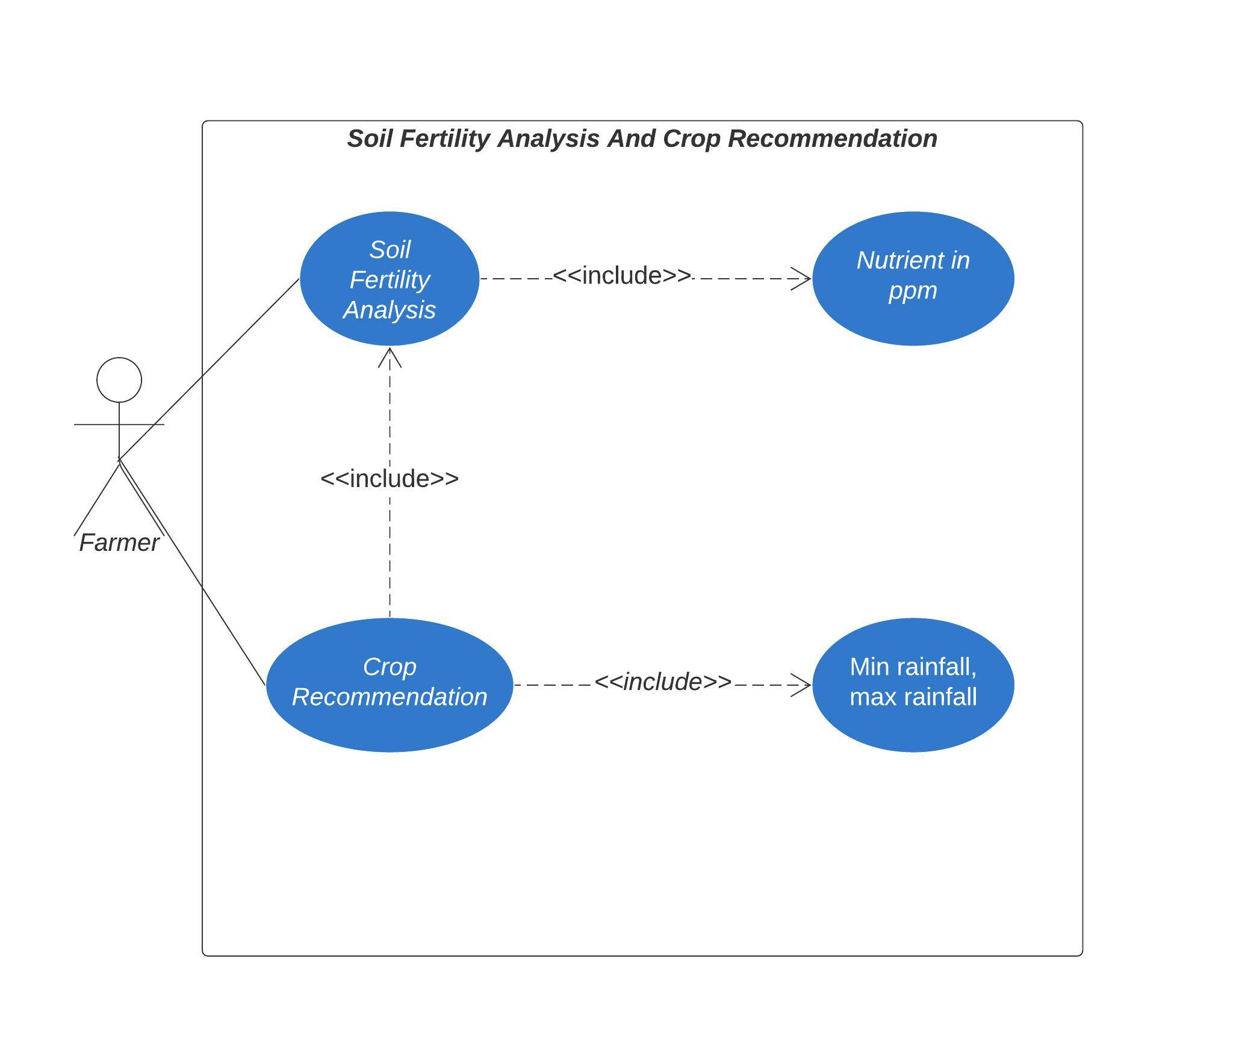
USE CASE DIAGRAM

Slide 5
Soil Fertility Analysis
This app predicts the fertility level of the soil using machine learning algorithm known as Random Forest Classifier.
Value of each nutrients is given as an input for which the model would predict the fertility level

Slide 6
Crop Recommendation
K-Means clustering algorithm is used to recommend crops based on predicted fertility, min rainfall and max rainfall.
Elbow plots was used to calculate the number of clusters. The optimum number of cluster was six.

Slide 7
Azure Deployment
Our web app is deployed by using Azure cloud.
We will be using Azure web app service which is PaaS model(Platform as a Service)

Slide 8
Existing vs Proposed System
Existing | Proposed
Soil is tested and analyzed to know the fertility level. | Value of nutrients can be given as an input and automatically fertility level can be determined.
Slow process since it involves human experts. | Fast process since it is computerized.
Difficult for farmers to know the fertility level. | Since it is web app it is easy to handle.

Slide 9
Future Plans
Currently generalized prediction is generated, in future we would like to include district wise predictions.
We would give prediction for fertility based on current location of user.
We are planning to add chatbot in our web app.
We would give visual analytics of soil fertility.

Slide 10


